Slide 1

7th Grade Math
Unit 9, Lesson 2 Adding Linear Expressions with Rational Coefficients Volume 2, pg. 46

Slide 2


Benchmark
MA.7.AR.1.1
Apply properties of operations to add and subtract linear expressions with rational coefficients.
volume 2, pg. 46

Slide 3
Integrated Mathematical Thinking and Reasoning Standards
MA.K12.MTR.2.1 Demonstrate understanding by representing problems in multiple ways.
MA.K12.MTR.5.1 Use patterns and structure to help understand and connect mathematical concepts.
volume 2, pg. 46

Slide 4

Learning Target
I can add linear expressions with rational coefficients.
volume 2, pg. 46

Slide 5

Warm-Up
volume 2, pg. 46

Slide 6
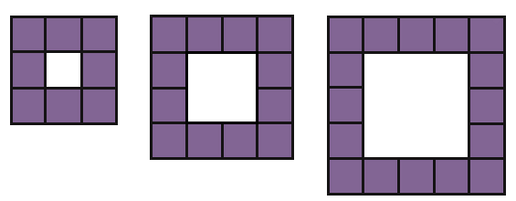
9.2.1 Warm-Up: Visual Patterns
Three figures are shown.
volume 2, pg. 46

Slide 7
What pattern do you see?
Explain how many small purple squares you think will be in the next figure.
volume 2, pg. 46

Slide 8

Exploration
volume 2, pg. 47

Slide 9

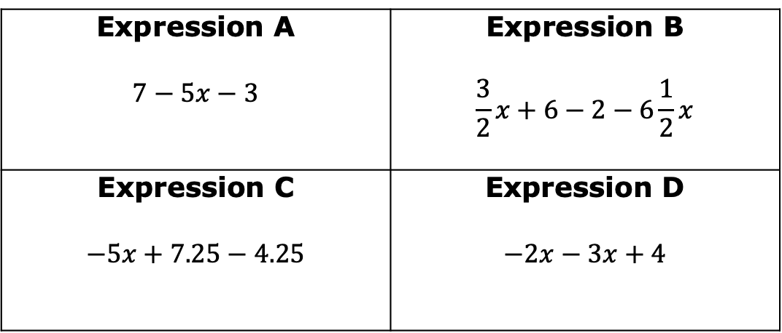
9.2.2 Exploration: Which One Doesn’t Belong?
Which expression does not belong with the other three? Explain your reasoning.
Expression A $$7−5x−3$$ | Expression B $$\frac{3}{2}x+6−2−6\frac{1}{2}x$$
Expression C $$−5x+7.25−4.25$$ | Expression D $$−2x−3x+4$$
volume 2, pg. 47

Slide 10

Collaboration
volume 2, pg. 47

Slide 11

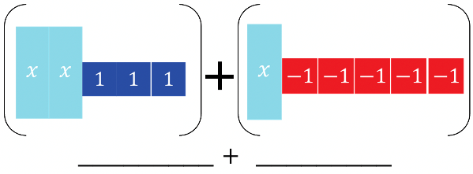
9.2.3 Collaboration: Adding Expressions with Algebra Tiles
Algebra tile representations of an expression are given. Work with your partner to find the sum by following the steps below.
On the lines, write the algebraic expression for each representation.
Rearrange the tiles to group like tiles. Draw the representation.
Eliminate any zero pairs to find the sum. Write the sum.
volume 2, pg. 47

Slide 12
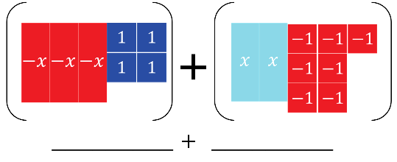
On the lines, write the algebraic expression for each representation.
Rearrange the tiles to group like tiles. Draw the representation.
Eliminate any zero pairs to find the sum. Write the sum.
volume 2, pg. 48

Slide 13

Guided Instruction
volume 2, pg. 48

Slide 14

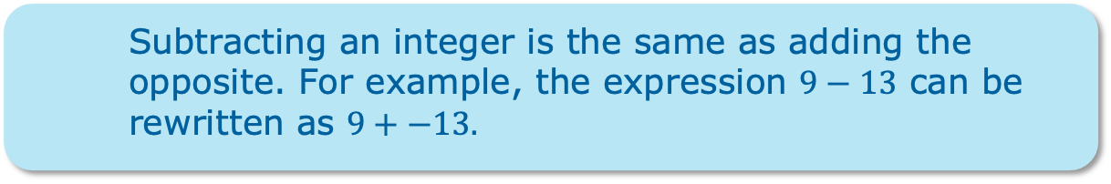
9.2.4 Guided Instruction: Adding Linear Expressions
When adding two expressions, rearrange the terms so that like terms are grouped together. Then add the coefficients of the like variable terms together and add the constants. Zero pairs are eliminated in this process.
Subtracting an integer is the same as adding the opposite. For example, the expression $9−13$ can be rewritten as $9+−13.$
volume 2, pg. 48

Slide 15
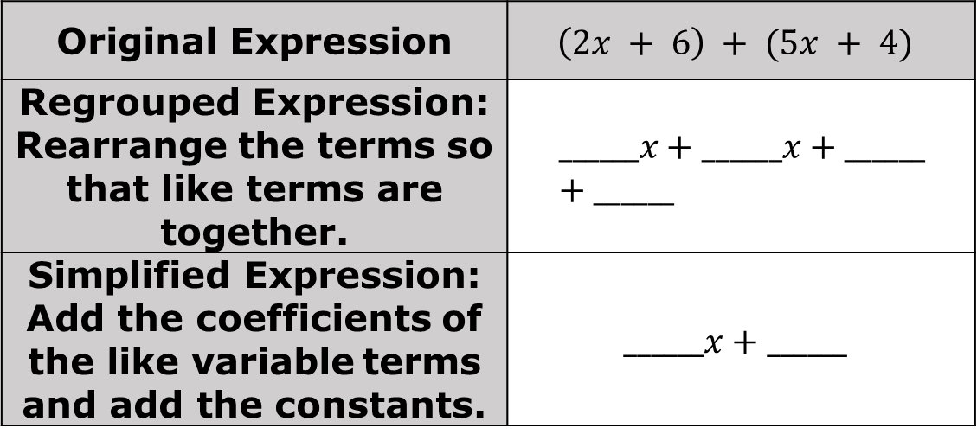
Find the sum of the two expressions.
Original Expression | $$\left(2x + 6\right) + (5x + 4)$$
Regrouped Expression: Rearrange the terms so that like terms are together. | $$______x+______x+______+______$$
Simplified Expression: Add the coefficients of the like variable terms and add the constants. | $$______x+______$$
volume 2, pg. 48

Slide 16
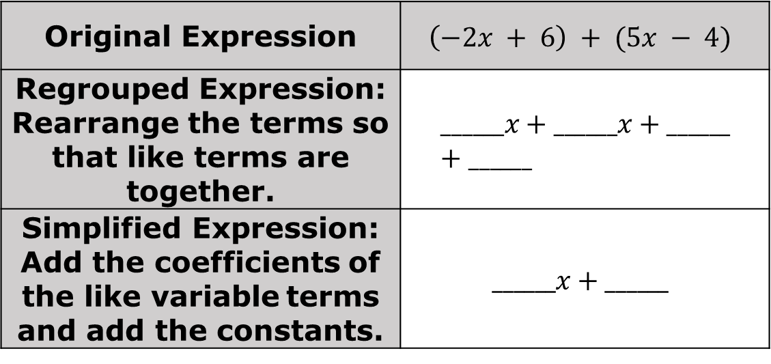
Original Expression | $$\left(−2x + 6\right) + (5x − 4)$$
Regrouped Expression: Rearrange the terms so that like terms are together. | $$______x+______x+______+______$$
Simplified Expression: Add the coefficients of the like variable terms and add the constants. | $$______x+______$$
volume 2, pg. 48

Slide 17
Collaboration
volume 2, pg. 49

Slide 18
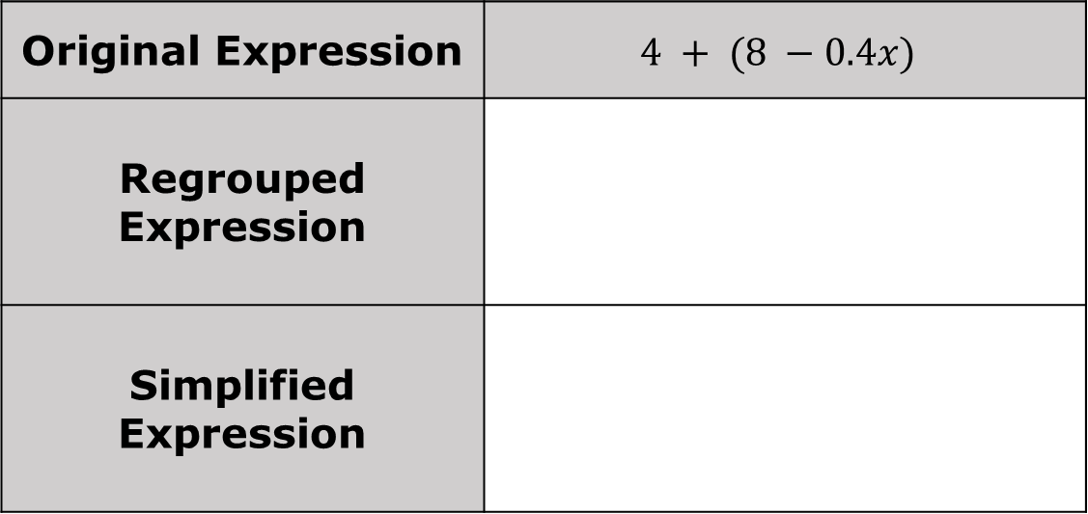
9.2.5 Collaboration: Adding Linear Expressions
Work with your partner to find the sum of the two expressions in simplest form.
Original Expression | $$4 + (8 −0.4x)$$
Regrouped Expression
Simplified Expression
volume 2, pg. 49

Slide 19

Original Expression | $$\left(3\frac{1}{2}x−\frac{3}{5}\right)+ \left(2\frac{1}{4}x + \frac{1}{3}\right)$$
Regrouped Expression
Simplified Expression
volume 2, pg. 49

Slide 20
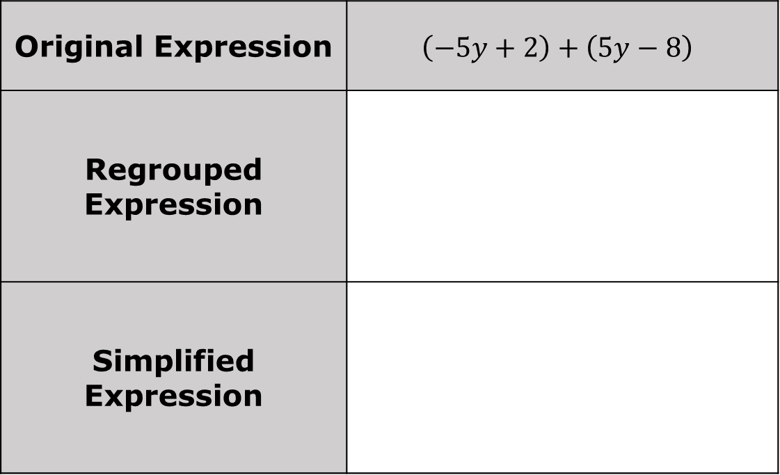
Original Expression | $$\left(−5y+2\right)+\left(5y−8\right)$$
Regrouped Expression
Simplified Expression
volume 2, pg. 49

Slide 21

Original Expression | $$(0.7−2.4x)+(4.1x−5.32)$$
Regrouped Expression
Simplified Expression
volume 2, pg. 49

Slide 22
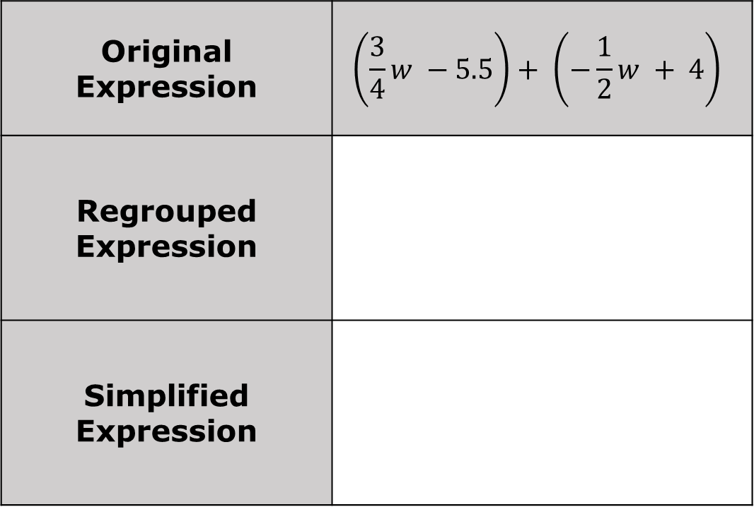
Original Expression | $$\left(\frac{3}{4}w −5.5\right)+ \left(−\frac{1}{2}w + 4\right)$$
Regrouped Expression
Simplified Expression
volume 2, pg. 50

Slide 23

Your Turn
volume 2, pg. 50

Slide 24
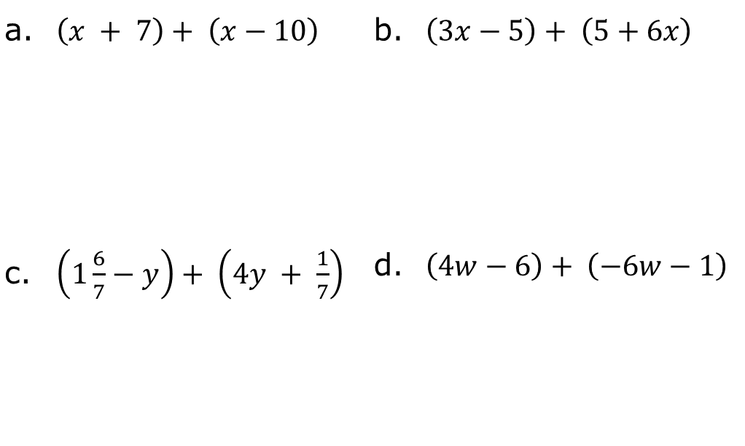
9.2.6 Your Turn!
Find the sum of each expression using the fewest terms possible.
$\left(x + 7\right)+ \left(x−10\right)$ | $\left(3x−5\right)+ \left(5+6x\right)$
$\left(1\frac{6}{7}−y\right)+ \left(4y + \frac{1}{7}\right)$ | $\left(4w−6\right)+ \left(−6w−1\right)$
volume 2, pg. 50

Slide 25
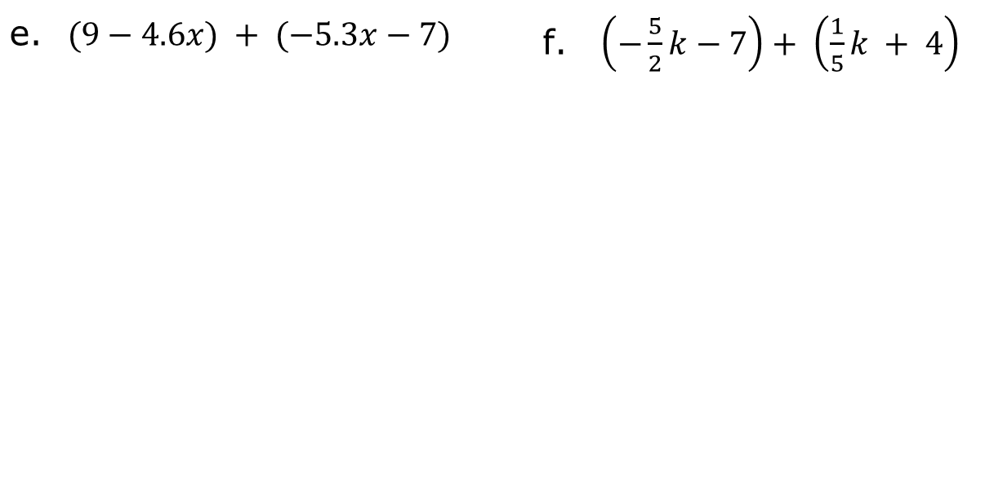
$(9−4.6x) + (−5.3x−7)$ | $\left(−\frac{5}{2}k−7\right)+ \left(\frac{1}{5}k + 4\right)$
volume 2, pg. 51

Slide 26

Wrap-Up
volume 2, pg. 51

Slide 27
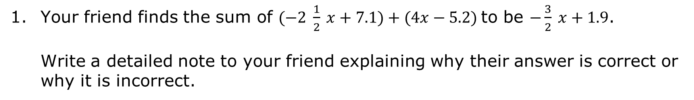
9.2.7 Wrap-Up: Error Analysis
Your friend finds the sum of $(−2 \frac{1}{2} x+7.1)+(4x−5.2)$to be $−\frac{3}{2} x+1.9$.
Write a detailed note to your friend explaining why their answer is correct or why it is incorrect.
volume 2, pg. 51

